Slide 1
Customer Satisfaction Prediction & Dashboard Report
A Data science project using Power BI , ML, Streamlit
Name: Priyanshu Pandey
Date: 08/ 082025

Slide 2
Problem Statement :
Create the intelligent system to predict the customer satisfaction level using machine learning models. It help to improve customer service quality. And create best interactive Power BI dashboard to help business enhance and decision making.

Slide 3
Tools & Technologies Used
• Python
• Python libraries( NumPy, Pandas, Seaborn, Matplotlib, Scikit-learn, Imblearn, Joblib, Streamlit)
• Power BI
• VS Code
• CSV Files

Slide 4
Dataset Description
Dataset name: customer_support_tickets.csv
Structure: There are 8469 rows and 17 columns
Columns Name: 'Ticket ID’, 'Customer Name’, 'Customer Email’, 'Customer Age’, 'Customer Gender’, 'Product Purchased’, 'Date of Purchase’, 'Ticket Type’, 'Ticket Subject’, 'Ticket Description’, 'Ticket Status’, 'Resolution’, 'Ticket Priority’, 'Ticket Channel’, 'First Response Time’, 'Time to Resolution’, 'Customer Satisfaction Rating'
Dataset Description
Dataset name: customer_support_tickets.csv
Structure: There are 8469 rows and 17 columns
Columns Name: 'Ticket ID’, 'Customer Name’, 'Customer Email’, 'Customer Age’, 'Customer Gender’, 'Product Purchased’, 'Date of Purchase’, 'Ticket Type’, 'Ticket Subject’, 'Ticket Description’, 'Ticket Status’, 'Resolution’, 'Ticket Priority’, 'Ticket Channel’, 'First Response Time’, 'Time to Resolution’, 'Customer Satisfaction Rating'

Slide 5
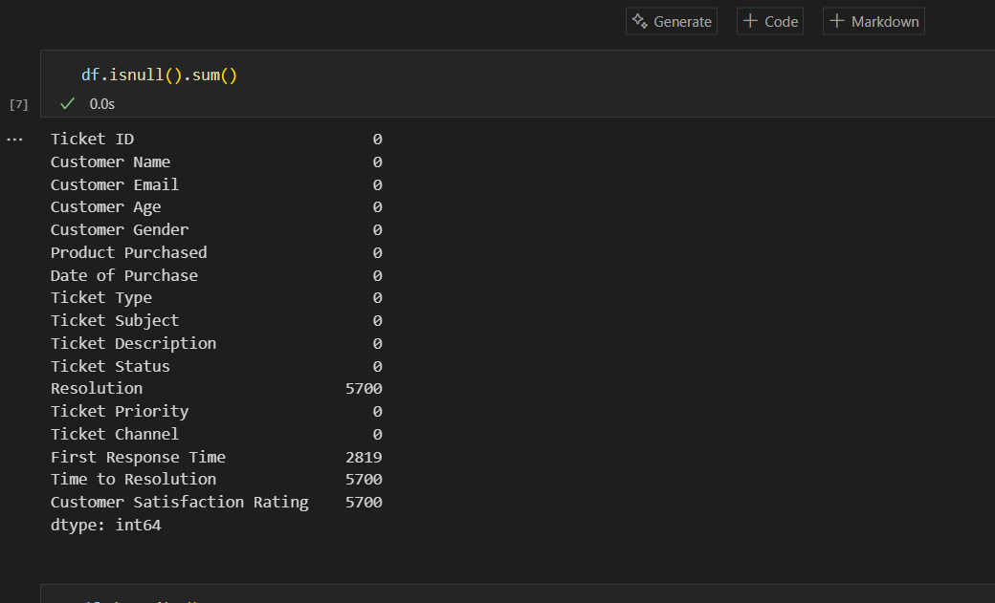
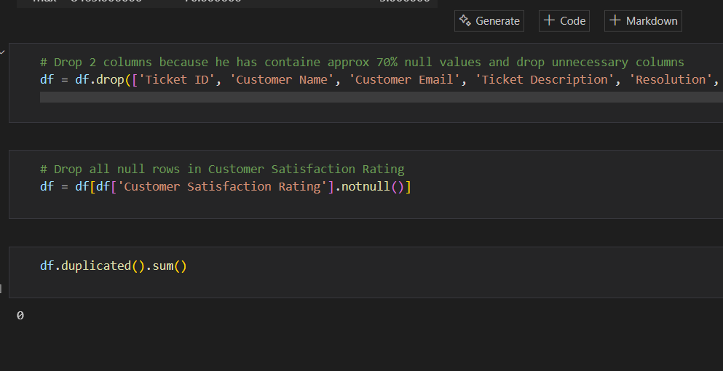
Data Cleaning & Preprocessing
Task Perform:
• Chack the null values and then remove null values
• Remove extra unnecessary columns
• Create new relevant columns for existing data
• Standardized data format
• Remove all duplicates

Slide 6
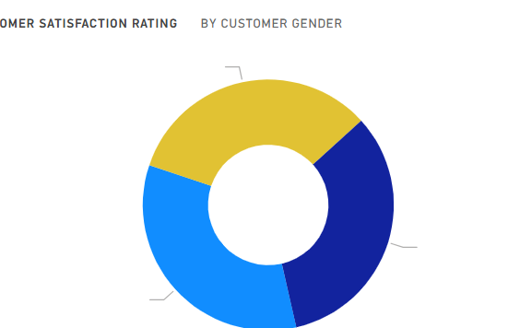
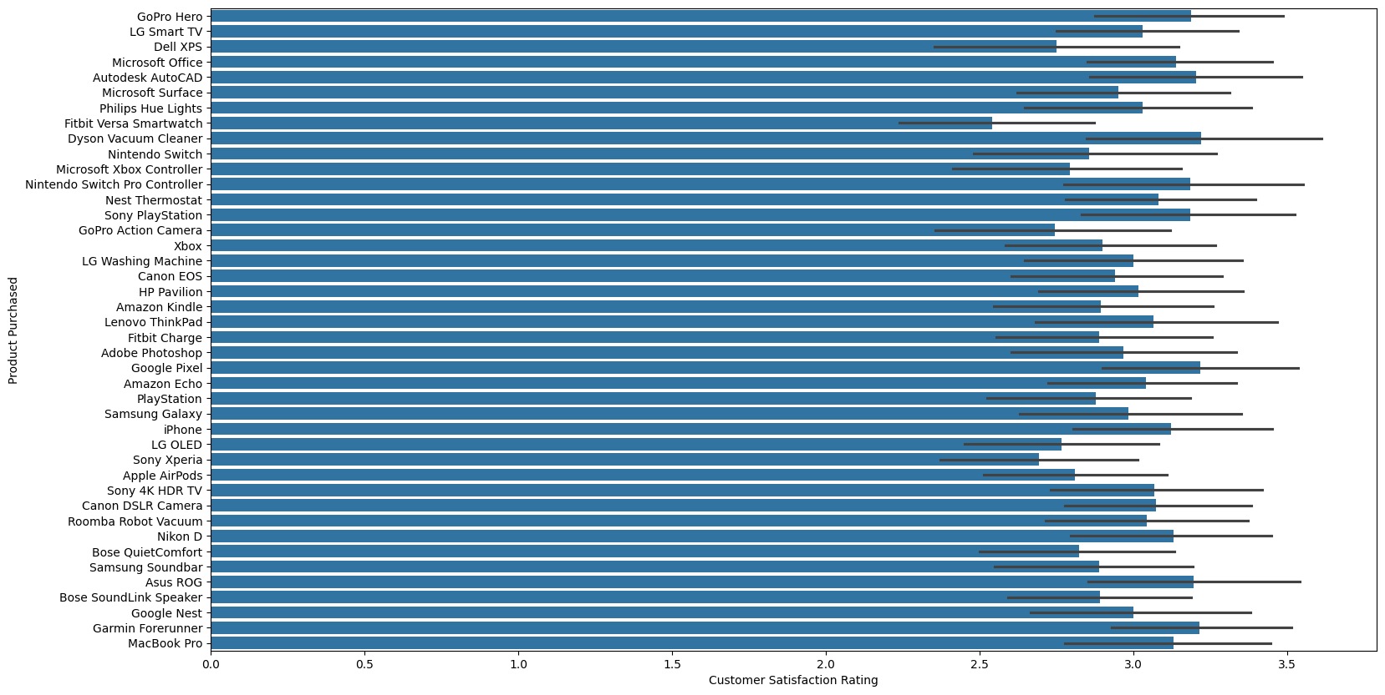
Exploratory Data Analysis
Using Python:
• Create bar chart
• Create line chart
• Create scatter plot
Using Power BI:
• Create line and stack column chart
• Create donut chat and card chart for
• Create cluster bar chat

Slide 7
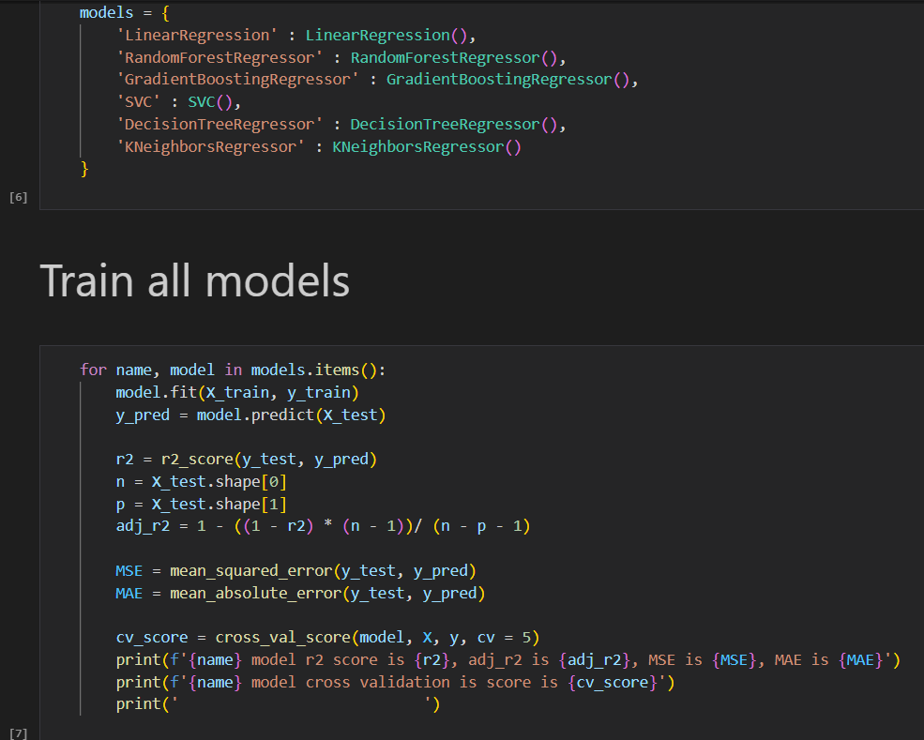
Model Training
• Train multiple model
• Best performing model : Gradient Boosting
• Model R2 score is 89%
• And Adjusted R2 score is 89%
• Cross validation score is (87%, 88%, 89%, 89%,
88%)

Slide 8
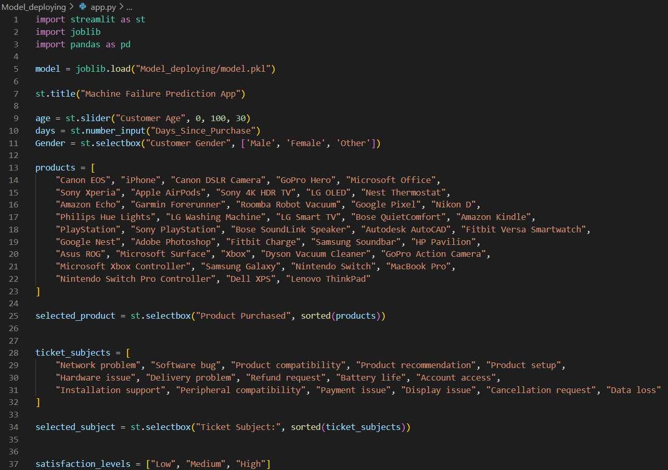
Model Deployment
• Use Streamlit to build my app
• Create basic interface and input field and create
Predict button

Slide 9
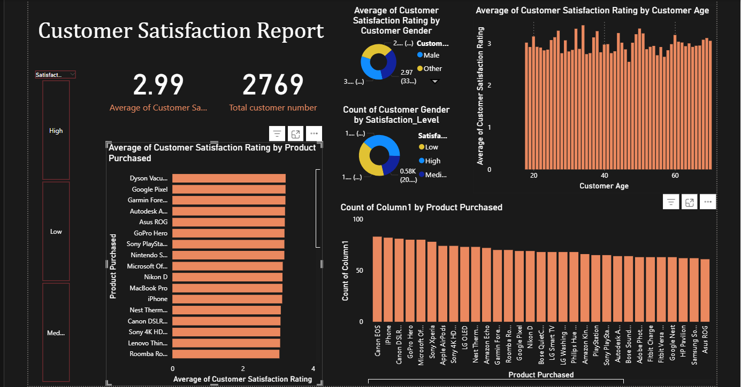
Power BI Dashboard

Slide 10
Dataset Description
Dataset name: customer_support_tickets.csv
Structure: There are 8469 rows and 17 columns
Columns Name: 'Ticket ID’, 'Customer Name’, 'Customer Email’, 'Customer Age’, 'Customer Gender’, 'Product Purchased’, 'Date of Purchase’, 'Ticket Type’, 'Ticket Subject’, 'Ticket Description’, 'Ticket Status’, 'Resolution’, 'Ticket Priority’, 'Ticket Channel’, 'First Response Time’, 'Time to Resolution’, 'Customer Satisfaction Rating'
Challenges Faced
• Handel null values in Target column
• Extract useful features
• Choosing the right model
• Deploying issues during model fit
• Create an interactive Power BI dashboard to enhance business decision-making.

Slide 11
Conclusion & Future Scope
• Conclusion:
• Project successfully deploy and its work properly and give good predictions.
• Future Scope:
• Add live Data stream.
• Improve model with more data and NLP or ticket description.

Slide 12
Thank You
Name : Priyanshu Pandey
GitHub : https://github.com/Priyanshu-techp
LinkedIn : https://www.linkedin.com/in/priyanshu-pandey

